Slide 1
Chatbot
Sr. No. | Names
1. | Prathmesh Pathari
2. | Rajesh Khandekar
3. | Kiran Shinde
4. | Vaishnavi Nikam
5. | Tina Patil

Slide 2

Problem Statement
As we all know on internet , information is in huge amount of data. Its too hectic to fetch any specific data from huge information. So to avoid that problem we have built the chatbot which will help to find the data. As per our question to chatbot it will find the similarity from information and give the response .
Why we have to use chatbot ?
What problems solved by using chatbot?

Slide 3

Algorithms
Downloaded pip install nltk and pip install newspaper.
Import libraries from newspaper.
Download punkt package.
Add article website.
Article is converted into text format.
Using tokenization convert text format into list of sentence.
7. Sending random greeting response to users greeting response.
8. Create a bot response using cosine similarity function.
9. Create a list for exit response.

Slide 4
Resources
Anaconda software
Jupyter book
spider
Python v3.8.9

Slide 5
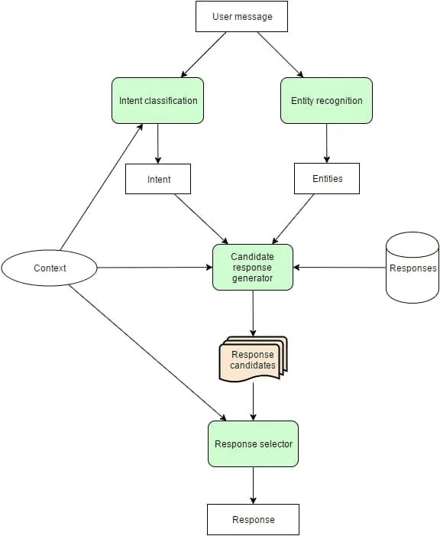
Flowchart

Slide 6
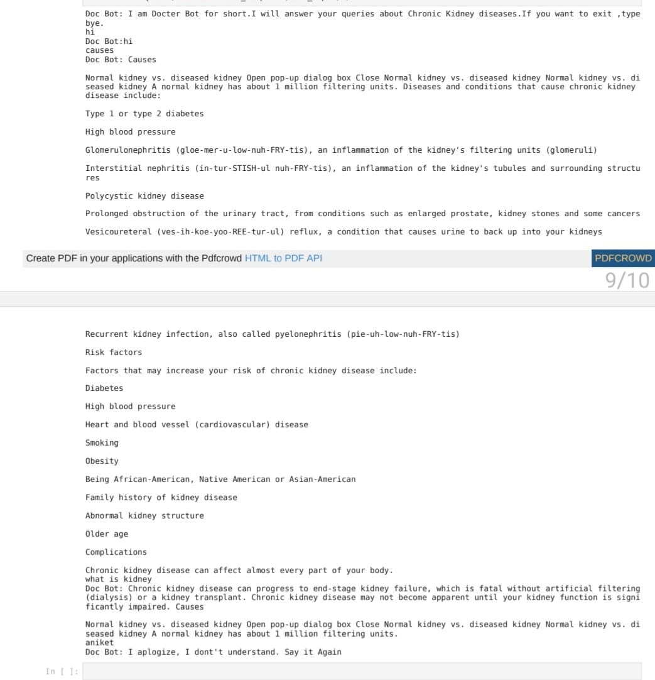
Conclusion

Slide 7
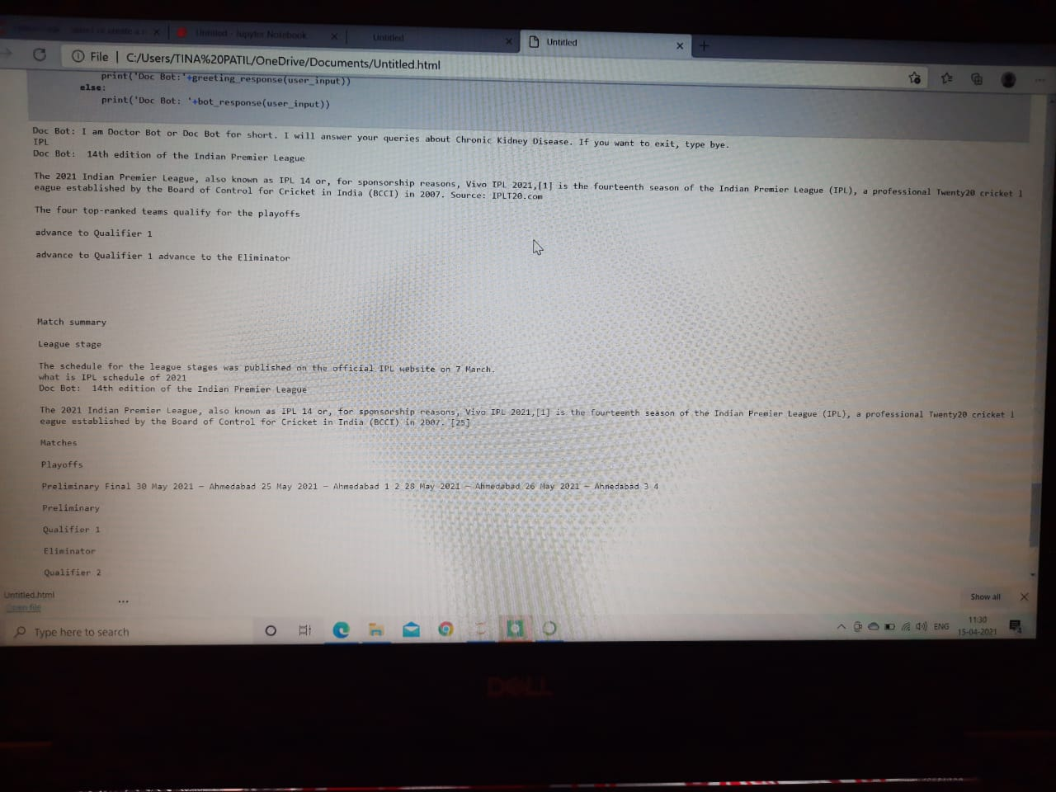

Slide 8
Support on any data given to program
Flexible chatbot according to data
Can implement on any websites even if the website who don’t have chatbot system implemented
User choice dependent and adaptable according to user demand

